Slide 1
Wat up with 3 & 4, like rly?
Benjamin Mitchell
Danielle Tadych
Jacob Ridlinghafer
IDK Man!!!

Slide 2
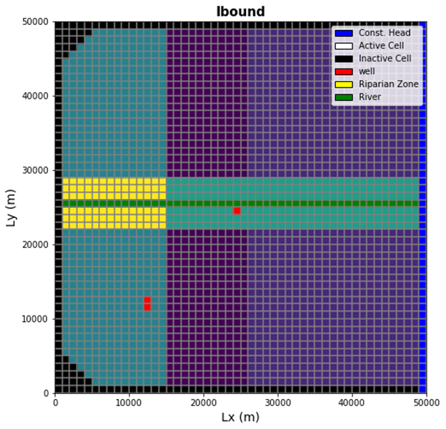
Boundary conditions
Monitoring Well 1
Town Well
Monitoring Well 2
Future Ag Well

Slide 3
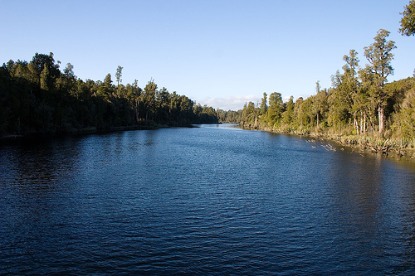
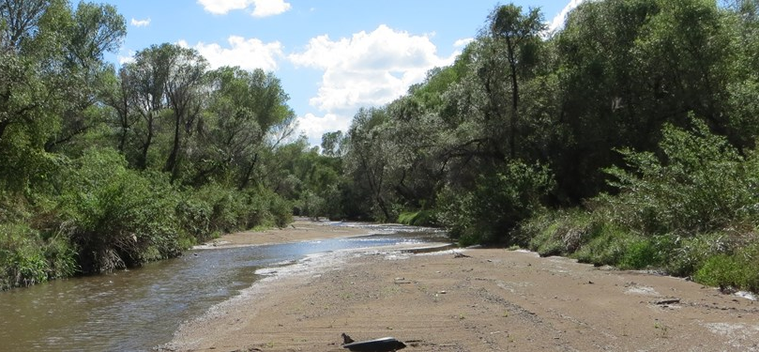
Assignment
Scenarios 3 and 4:
Post-Development
Steadily increasing water demand
Project for 125 years
25 years for burn in
Exponentially increasing Q Q = 1.5*t^{1.5}
On year 26 pumping starts at 47 m3/day
Project for 225 years
Scenarios 1 & 2:
Pre-development
No town water demand
Run the model for 25 years with varying ET
Determine how long it takes to reach steady state

Slide 4
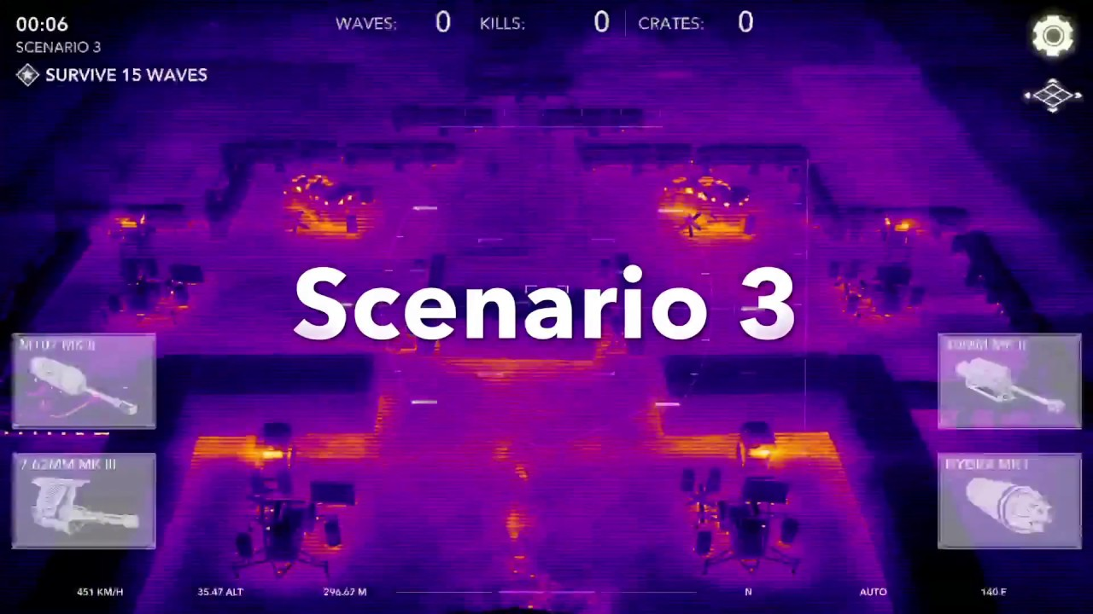
Scenario 3

Slide 5
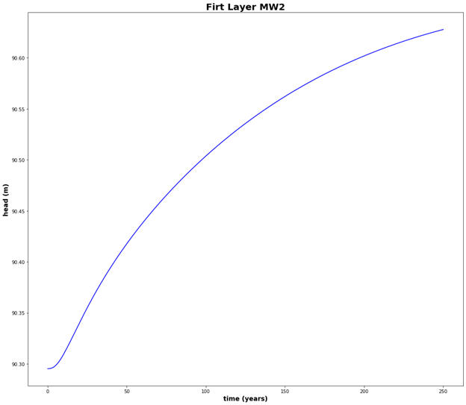
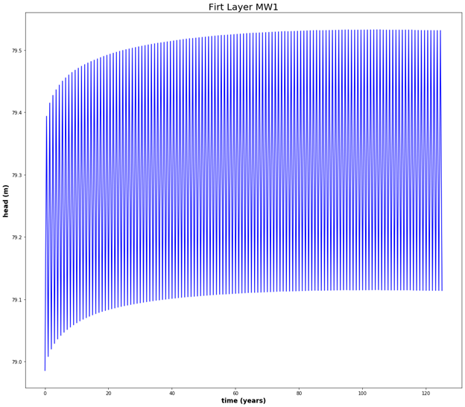
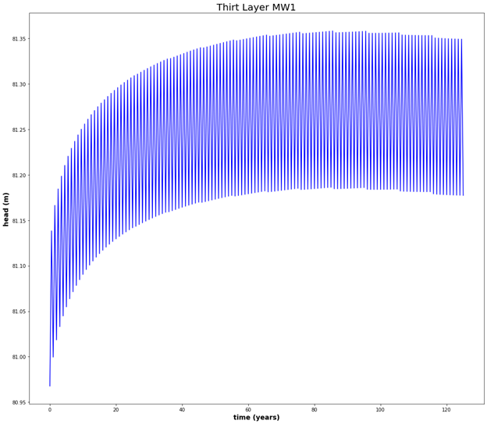
Scene 3

Slide 6
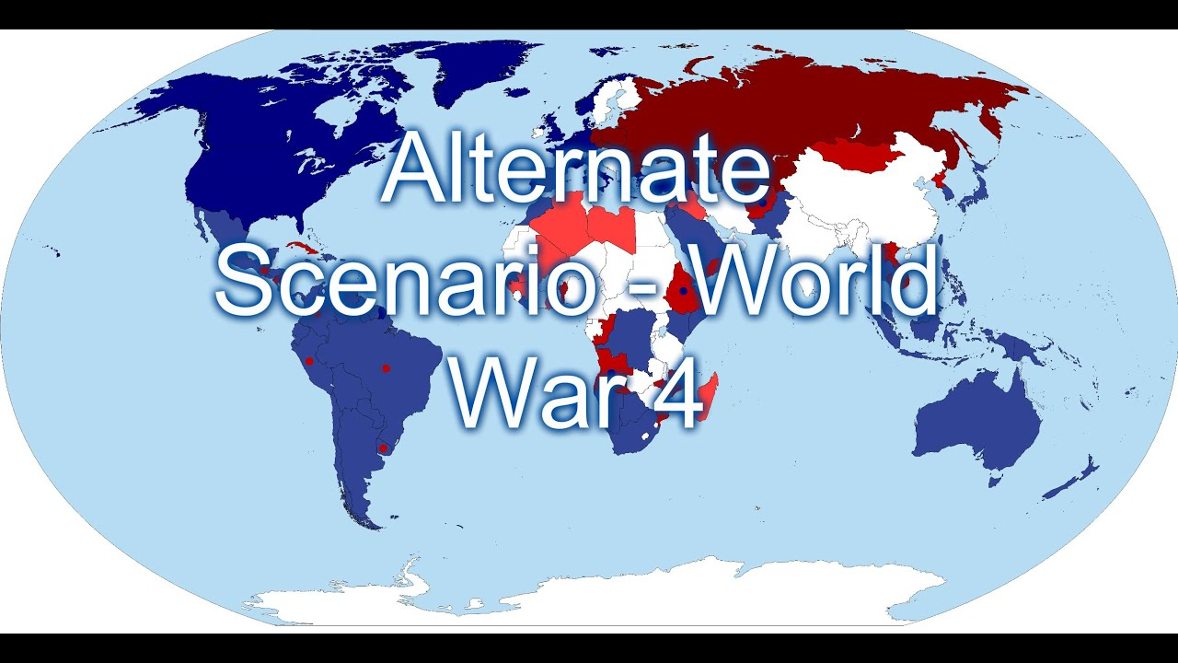
Scene 4
#Head for MW1

Slide 7
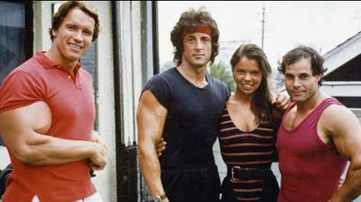
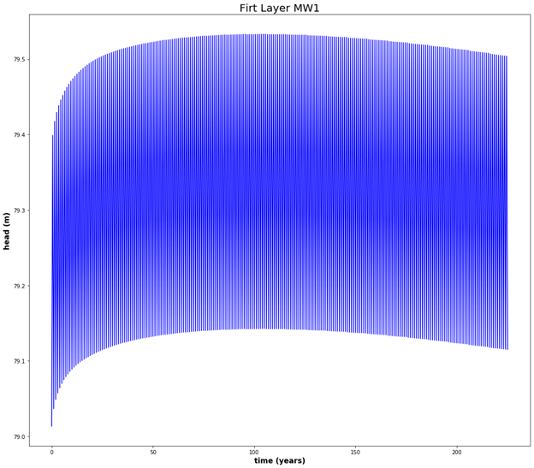
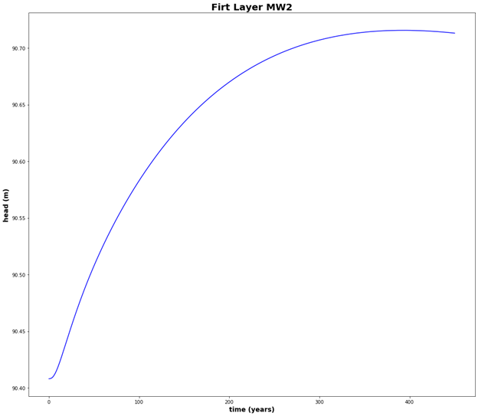
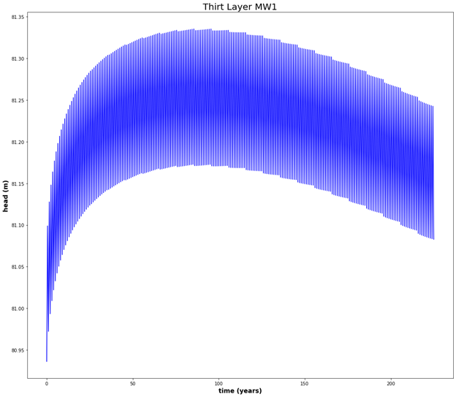
Scene 4- With Pumping

Slide 8

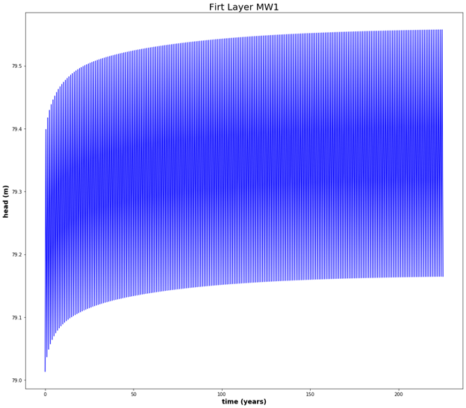
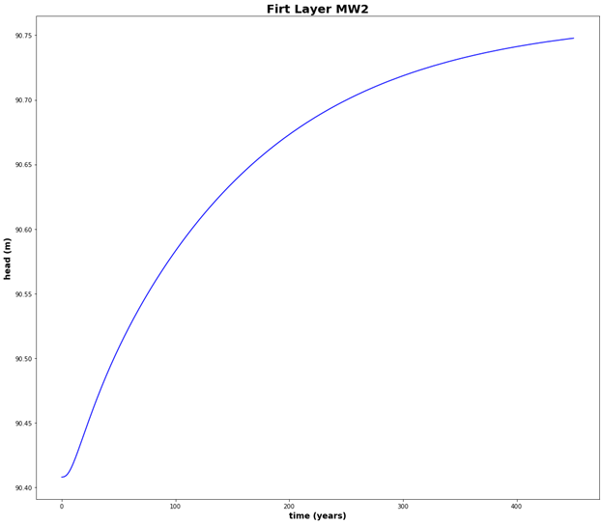
Scene 4- Without Pumping
#Head for MW1
#Head for MW2

Slide 9


